Slide 1
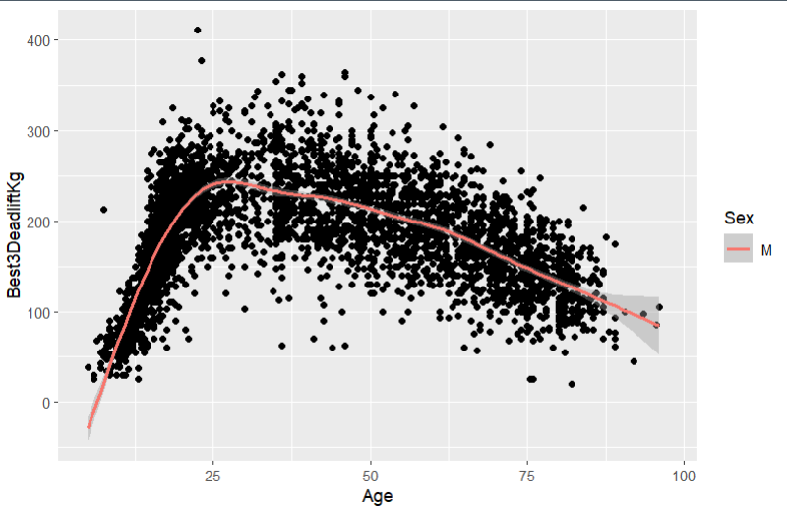
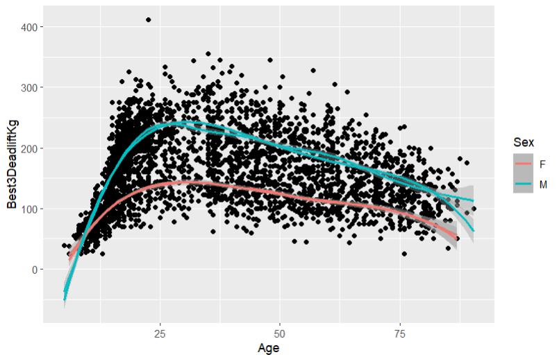
Modeling the Impact of Age on Powerlifting
Sarah Sheldon '25 (Statistics) and Josh Larson '25 (Mathematics)
Advisor: Dr. Ivan Ramler (Statistics)
Sarah Module:
Goal: create model using Age and Sex as variables for predicting Best3DeadliftKg
Want to see if Age has an effect on strength
Score:
Funded by the National Science Foundation with the goal of promoting statistics and data science education using sports data
Modules are created by faculty and students to be used as classroom tools
Josh Module:
Powerlifting:
Lifting sport where competitors in the same weight classes compete to lift the heaviest amount of weights
3 different categories of powerlifting: Bench, Squat, Deadlift
Different types of equipment
*
*
*
Look at male curve alone first
Data Cleaning:
Got rid of any missing variables
Filtered out lifters that didn’t place
Filtered to one competition with two different equipment types in order to narrow down the amount of data points
Add female curve next
Learning Objectives
High order models with indicator variables
Choosing model of best fit

